Slide 1
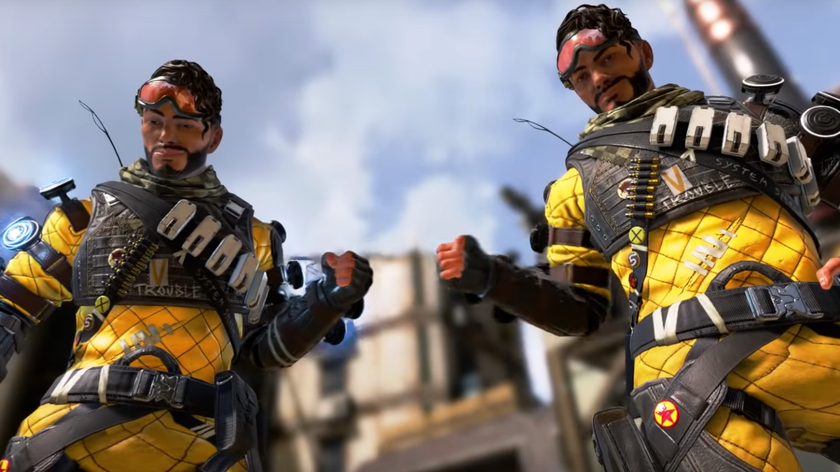
"You got bamboozled!"

